Slide 1
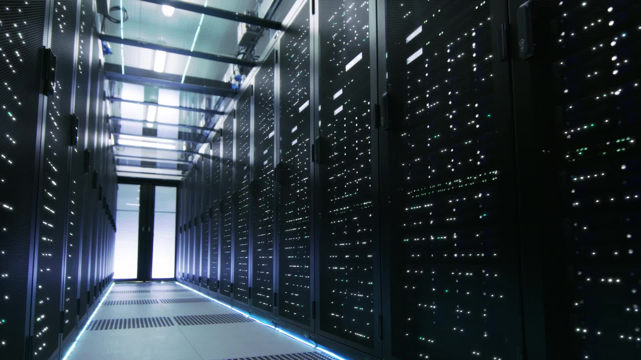
Data Center Architecture
CE-408 Cloud Computing
Week 13
Safia Baloch

Slide 2
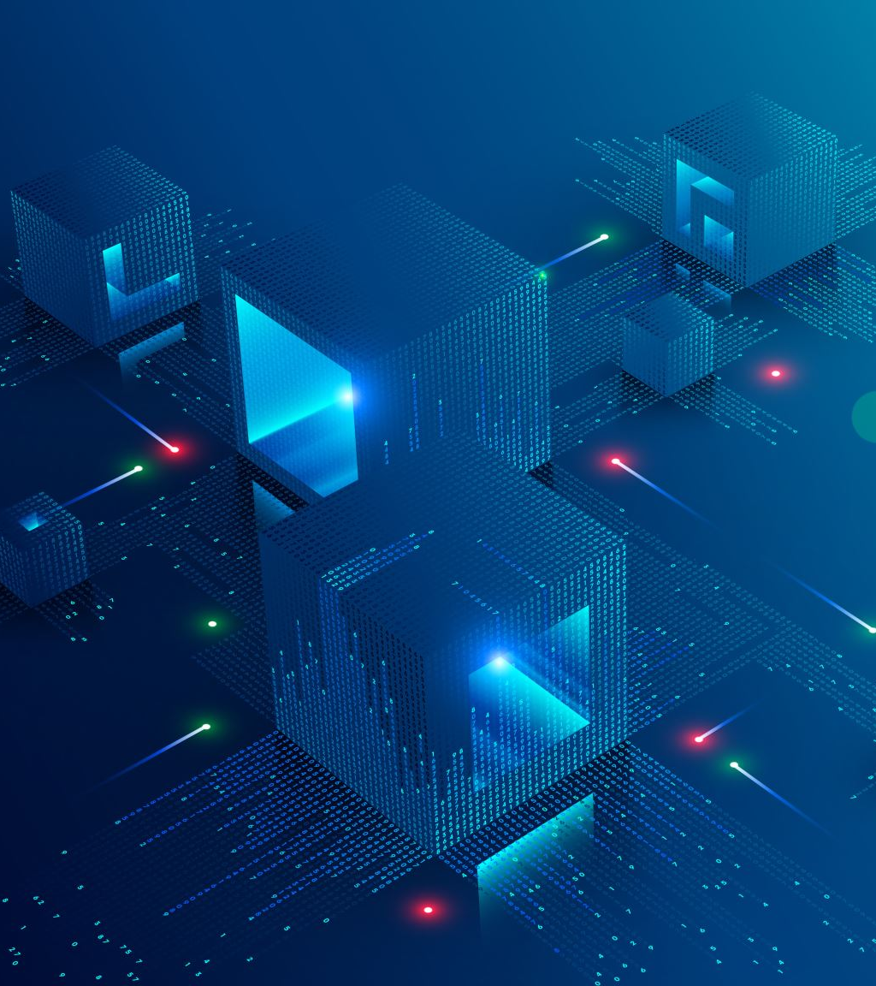
Data Center
Data center architecture refers to the design and layout of a computing facility that houses
servers, storage systems, and networking equipment for processing, storing, and distributing large amounts of information.
Requirements:
Physical space
Security Measures,
Power and Cooling systems
Network connectivity
Software to ensure optimal performance

Slide 3
Component of Data Center Architecture
Compute: rack server, blade servers, tower servers.
Storage systems:
SANs: Storage Area Networks
NAS: Network Attached Storage
DAS: Direct Attached Storage
Networking Equipment: Switches, routers, firewalls, and load balancers
Power Infrastructure:
CRAC: Computer Room Air Conditioning Unit
LCS: Liquid cooling systems, and
hot/cold aisle containment for optimal temperature and humidity levels for hardware
Security Systems:
Management Software:
DCIM: Data Center Infrastructure Management software

Slide 4
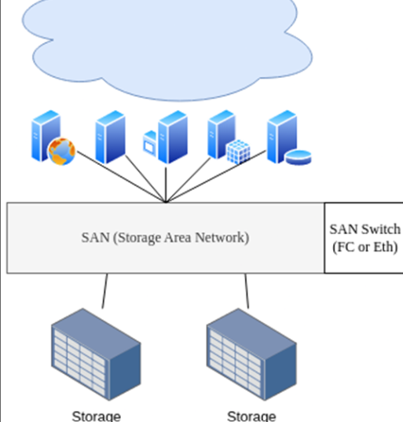
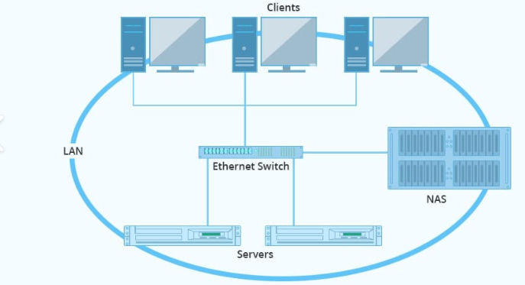
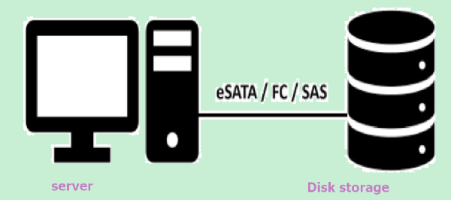
Storage Architectures for Data Center
Types of physical storage devices
Configuration ( DAS, NAS, SANs)
DAS: without network connection in between, storage direct connected to physical server. ( SATA, SCSI, RAID controller).
NAS: Storage accessed through LANs via TCP/IP, without application server.
SANs: high speed network to connect storage device with servers with fiber channel protocol.

Slide 5
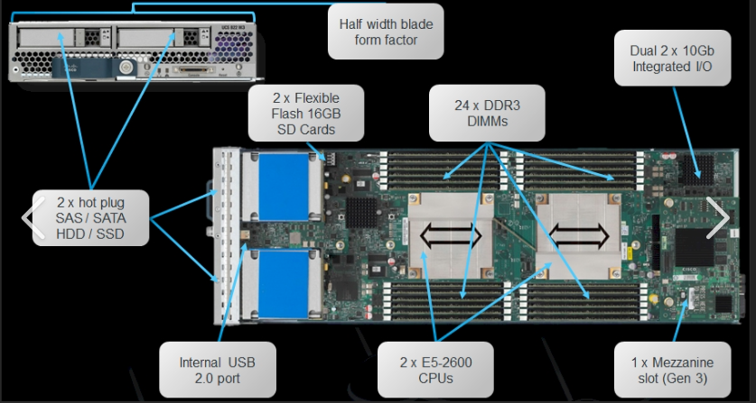

Server Architecture for Data Centers
Physical structure:
Rack: An encased server used to stack and install several servers in a large closet.
Blade: An encased server used to insert small servers into a blade bay where several can be stacked horizontally in a rack.
Tower: A stand-alone computer that looks like a standard desktop but has additional server resources installed in the machine.
Resource structure:
CPU
Memory
Storage
Network
GPU

Slide 6
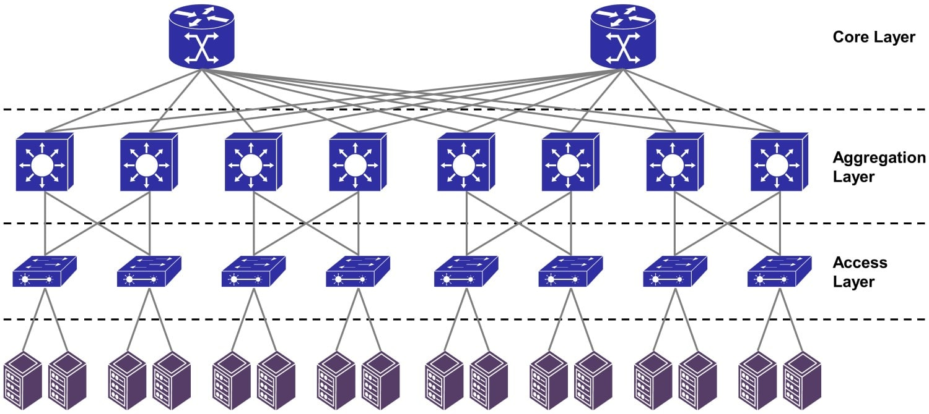
Network Architecture
Interconnected nodes and pathways to facilitate communication and data exchange including physical, logical layout of network.
Three tier Architecture
L3: entry point, ToR
L2: distribution layer, redundant switches
L1: backbone, interlink l2 to external network,(high end switches, cables and routing protocols)
Spine-leaf architecture
Network Function Virtualization
Hardware appliances, firewalls, routers, load balancers (SDN controller)

Slide 7
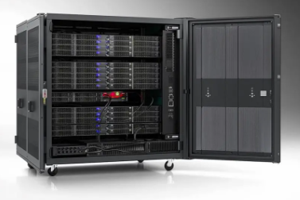
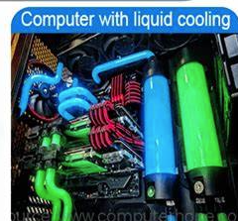
Design Systems
Enterprise Data Centers: specific need of an organization
Colocation Data Centers : shared infrastructure for multiple customers
Hyperscale Data Centers: The actual cloud service vendors data centers
Edge Data Center: closer to end users.
Containerized Data Center: Potable Micro Data Centers
Artificial Intelligence Data Centers. Specialized facilities for AI workloads, high performance computing with liquid cooling systems

Slide 8
Microsoft reveals its MASSIVE data center (Full Tour) – YouTube
Microsoft reveals findings from Project Natick, its experimental undersea datacenter
Inside a Google data center
Data Centered: Dallin, Tasha, Fidel | Amazon Web Services
Google Data Center Security: 6 Layers Deep
Inside the AWS Lab Where Retired Data Center Hardware Gets a Second Chance | Amazon Web Services

Slide 9
Cloud Infrastructure

Slide 10
Amazon

Slide 11
Google Cloud

Slide 12
Microsoft

Slide 13
Open Source Cloud Computing : Private Cloud
Ecualyptus
OpenNebula
Nimbus
OpenStack

